Slide 1
CASE TOOLS
CASE tools are computer-based products that help developers implement one or more phases of the Software Lifecycle (SDLC) and help us eliminate planning, development, design, and implementation problems.

Slide 2

The contribution of CASE tools to software quality?
Many organizations use quality tools to help monitor and manage quality initiatives. There are several different types of tools that can be used, and these tools are used when there is a problem that needs solving.

Slide 3

Monday.com:
monday.com is a Work Operating System (Work OS) that powers teams to run projects and workflows with confidence. It’s a simple, but intuitive, Work OS for teams to shape workflows, adjust to shifting needs, create transparency, connect collaboratively, and stop doing manual grunt work.

Slide 4
You can also use Monday.com software for:
• Sales pipelines
• Marketing campaigns
• Recruitment processes
• Video production planning
• Tasks management
• Progress tracking
• Product roadmaps
• Business processes
• Design planning
• Bug tracking
• Event management
• Construction planning

Slide 5
Note:
More than 80,000 teams in diverse industries around the world rely on monday.com, from big companies like Wix and The Discovery Channel to small businesses just getting started.

Slide 6
What can I do on Monday.com:
you can build your workflows in any way that works for you and your team. This is one of the main reasons why so many teams across industries and oceans have embraced this platform.
You can also add team members to your boards and delegate work to be done by assigning one or more team members to each item.

Slide 7
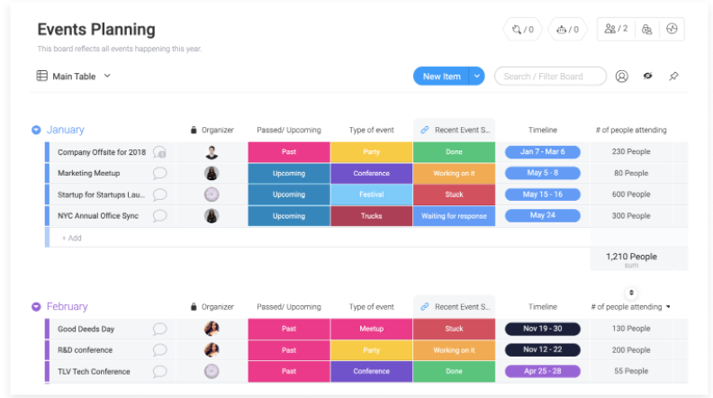
Monday.com feature:
Time Tracking.

Slide 8
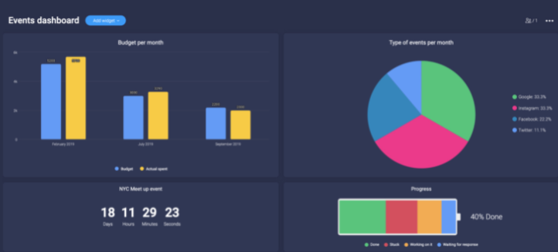
Monday.com feature:
Dashboards

Slide 9
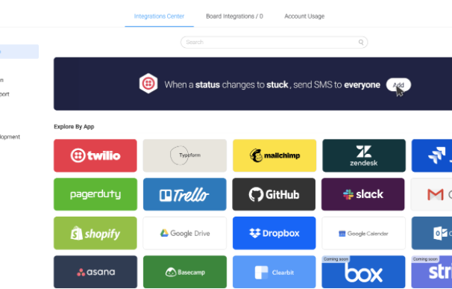
Monday.com feature:
Integrations

Slide 10
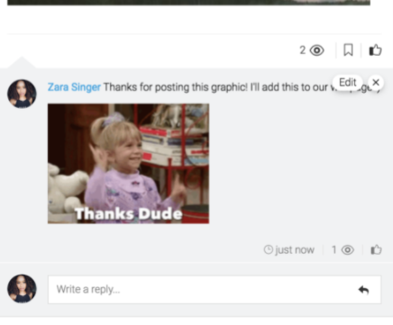
Monday.com feature:
Easy communication and collaboration.

Slide 11
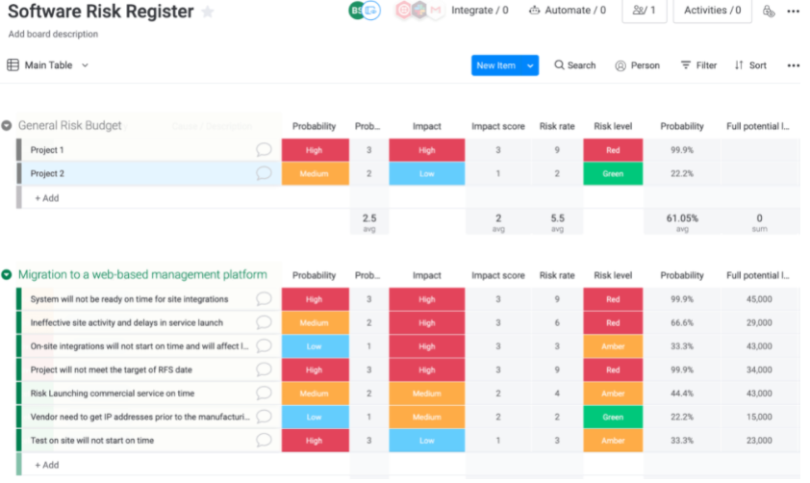
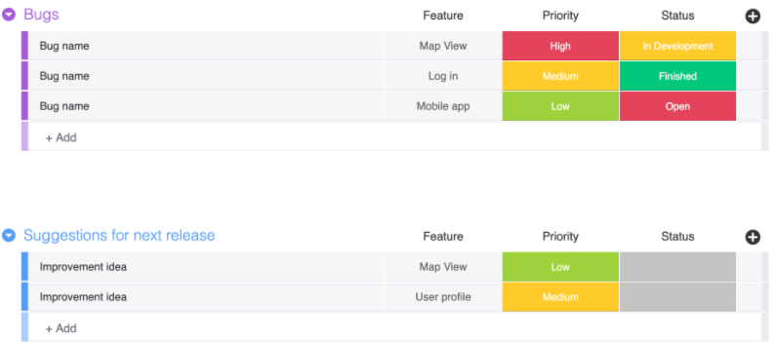
How to improve software quality assurance:
Bug reporting.
2. Risk register

Slide 12
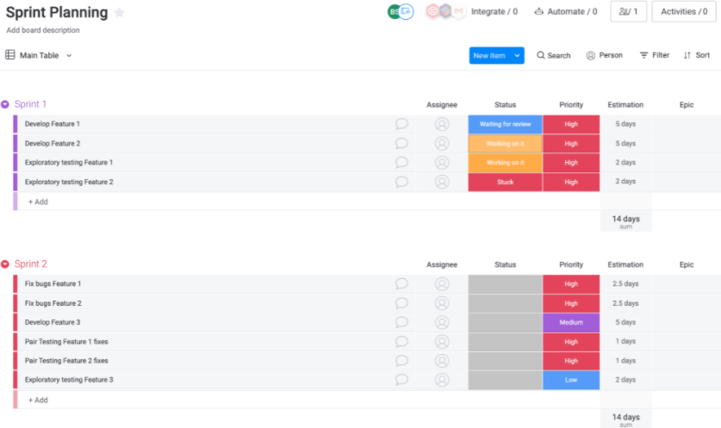
How to improve software quality assurance:
3. Shift Left planning.

Slide 13
How Monday tools contribute to the maintenance Timelines for the development process and keeping up with budgets (progress monitoring)?
This will give us the total project budget at the bottom of the column.
But what about the amount of money we've actually spent on each task? To track this, we can add another Numbers Column where we can input all the money actually spent.
Check if you're within budget.
Know how much budget is left.
Highlight important data.
View your budget breakdown.
Automate your workflow.
Track your progress with a dashboard.
https://support.monday.com/hc/en-us/articles/115005311969-How-Can-I-Manage-My-Budget-with-monday-com-

Slide 14
Reference:
http://www.umsl.edu/~sauterv/analysis/488_f02_papers/CASE.html.
https://www.appvizer.com/operations/project-management/mondaycom#presentation.
https://support.monday.com/hc/en-us/articles/115005310945-What-is-monday-com-
https://support.monday.com/hc/en-us/articles/115005311969-How-Can-I-Manage-My-Budget-with-monday-com-.

Slide 15

Student Name | ID
Alaa Nassar | 201820292
Ahmad Nassar | 201610100
Sara Jaber | 201811013
Dr. Ahmad Shubita

